Slide 1
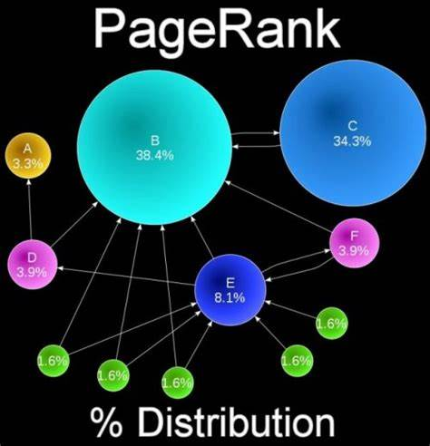
The Maze-Depth-First Traversal
CS570 - Big Data Processing & Analytics
Submitted by: Divya Pandey(19665)
Instructor: Dr. Henry Chang

Slide 2
Table of Content
Introduction
Design
Implementation
Test
Enhancement Ideas
Conclusion
References

Slide 3
Introduction
DFS Algorithm is used to generate the maze.
It is graph/tree traversal algorithm that follows a path as far as it can until it either, reaches the goal
It can start from a random point and keep digging paths in one of 4 directions(up, right, down, left) until you can’t go any further
Application: Self Driving Car, Legged Robot

Slide 4
Design
Robot | Clear Route(Street, Highway) | Unclear Route(Hotel,Hospital)
Without Wheel(Legged Robot) | Tree
With Wheel(Self-driving Car) |  | Matrix

Slide 5
Design
Clear Route(Street, Highway)-Tree
We'll choose a random cell to start from and traverse the grid using depth first search.
Whenever a new cell is visited, the wall between the new cell and the previous cell is knocked down.
The start cell (or root node) will always be the top-left most cell
The exit cell (or goal node) will always be the bottom-right most cell

Slide 6
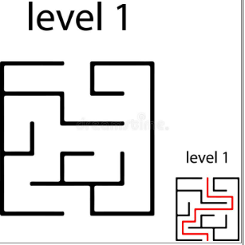
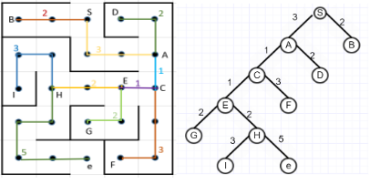
Design

Slide 7
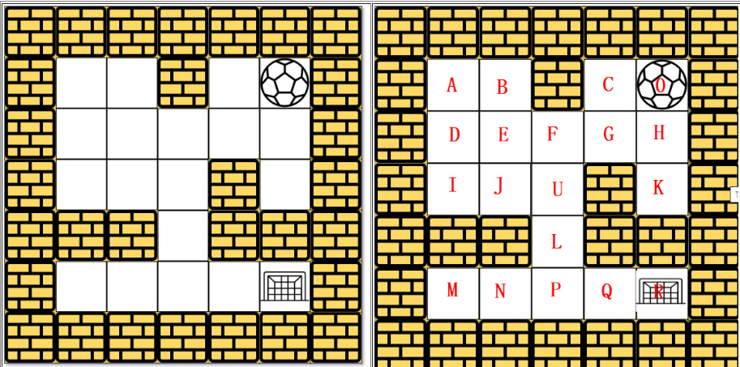
Design
UnClear Route(Hotel, Hospital)-Matrix
The ball can go through the empty spaces by rolling right, left, up, down, but it won't stop rolling until hitting a wall.
When the ball stops, it could choose the next direction.

Slide 8
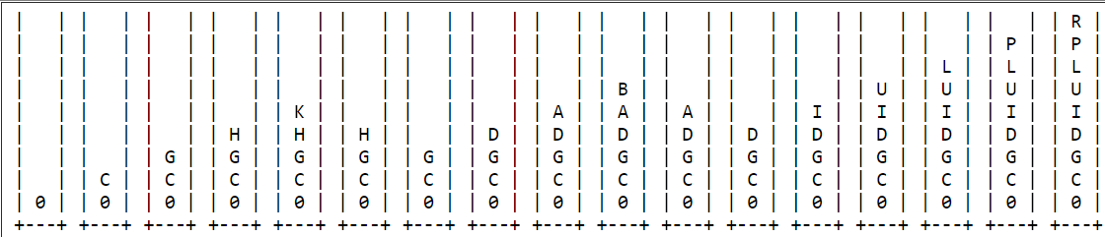
Design
UnClear Route(Hotel, Hospital)-Matrix
R is the Final Destination

Slide 9
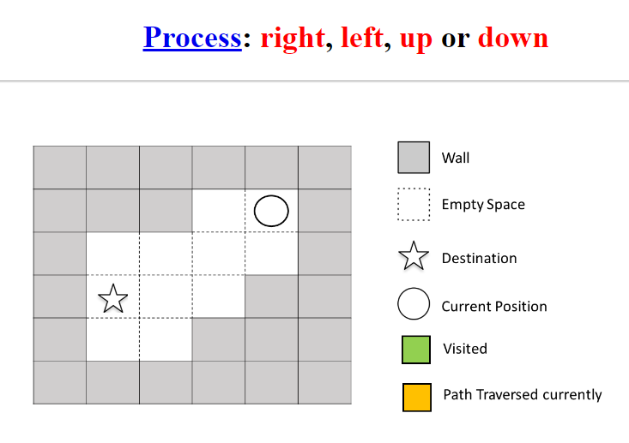
Design
UnClear Route(Hotel, Hospital)-Matrix

Slide 10
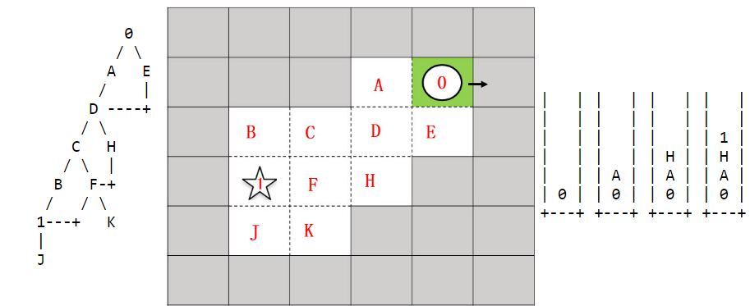
Design
UnClear Route(Hotel, Hospital)-Matrix
Start:
0: right →hits wall
A: left →hits wall
H: down→ hits wall
I: Destination

Slide 11
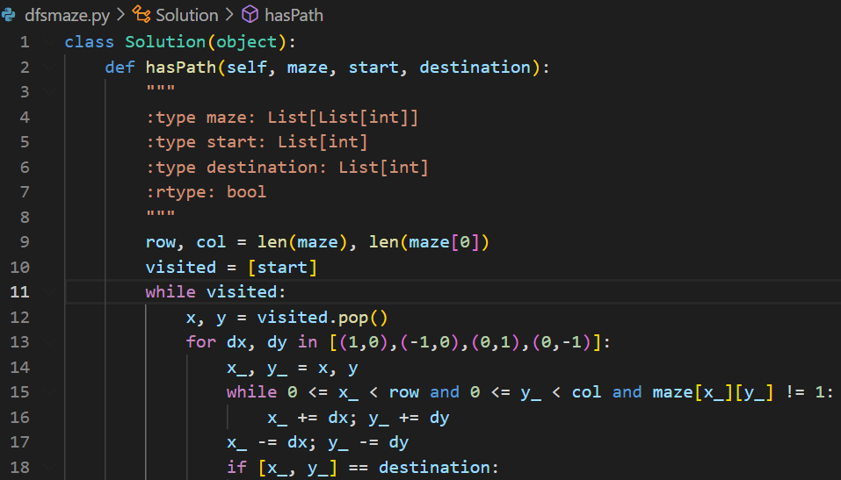
Implementation
Download dfsmaze.py program.
Python3 dfsmaze.py (Compiler)
Or you can run this program into visual Studio

Slide 12
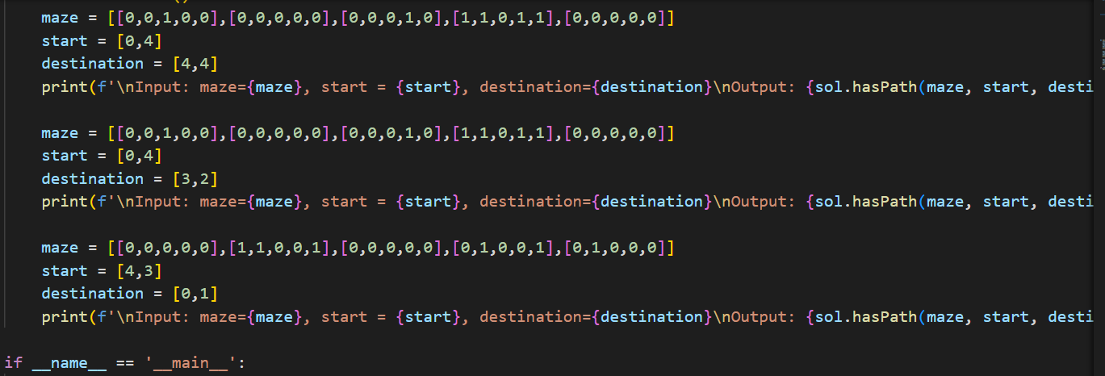
Test Case

Slide 13
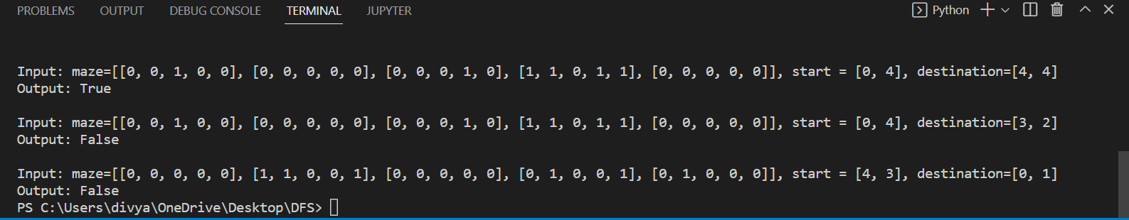
Test Result

Slide 14
Enhancement Ideas
Find the shortest path from Breadth First Algorithm and solve the maze problem
Implement Legged Robot with Unclear Route without wheel
Implement Self-Driving Car with Clear Route with wheel.

Slide 15
Conclusion
DFS algorithm to used to solve maze problem.
It finds an unexplored path, and then explores it, and also can solve shortest path

Slide 16
References
Blueandhack. (n.d.). Blueandhack/node-time-server. GitHub. Retrieved November 13, 2022, from https://github.com/blueandhack/Node-Time-Server

